Slide 1
Low Power High Performance Reconfigurable Computing using FPGAS
Ryan Melendez (E.E.)
Burhan Alestwani (E.E./C.E.)
Advisor: Mohamed El-Hadedy (Aly)
May 6, 2019

Slide 2
Presentation Outline
Introduction
Abstract
Background
The State of Processing
Soft vs. Physical Cores
Memory design and management
Requirements
MultiCore Processing and Scalable Design
Constraints
Design
Pipelined Design
Current Implementation
Benchmarking Results

Slide 3
Introduction (Abstract)
As the demand for computational power increases, the need to develop cost efficient, application based, methods for computing is constantly rising. To help solve this issue, our research is dedicated towards developing low power computational technology while being a cost-efficient solution compared to other resources. The project is aimed towards using Field Programmable Gate Array (FPGA) platforms that can be reconfigured and applied for use in image processing, data mining, and medical applications. The objective is to implement the maximum units of soft-core processors (Micro-Blaze) efficiently on a single FPGA chip while using the minimum amount of resources. The next objective is to design communication interfaces to connect the multiple low-power FPGA platforms for rapid scalability. This allows the FPGA boards to be used in large scale projects and support the high computational demand for power-hungry applications

Slide 4
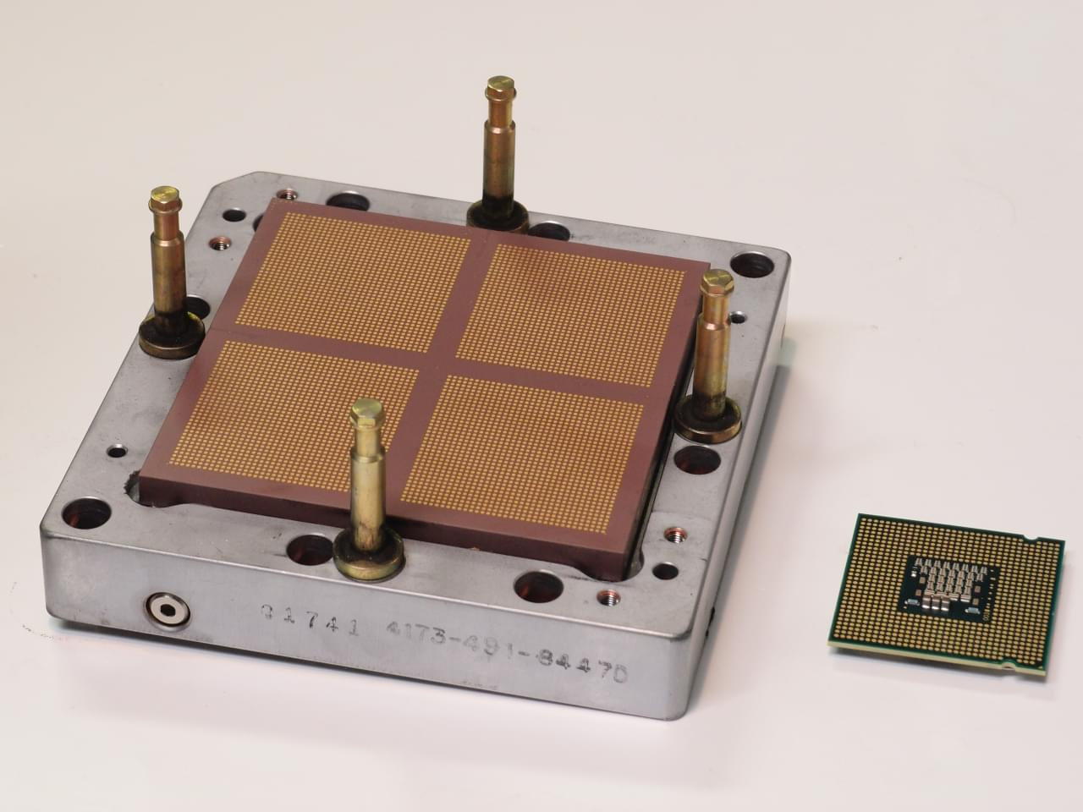
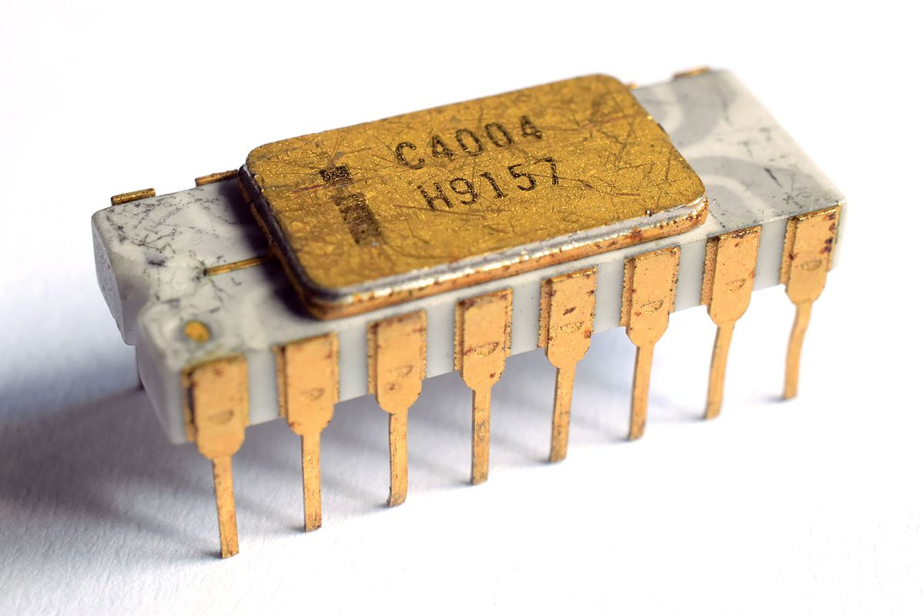
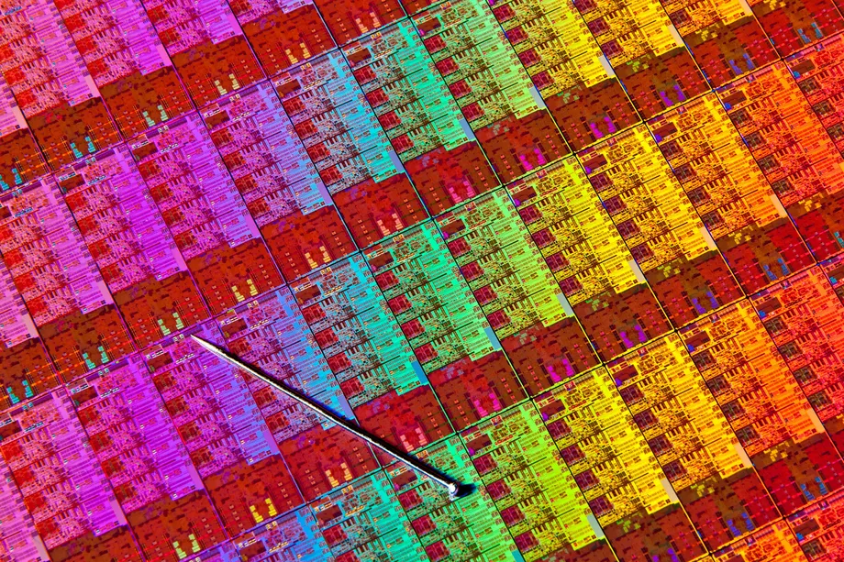
Background: The state of processing
The first commercially available central processing unit (CPU) was created by intel in 1971, named the Intel 4004, which was a 4-bit 740kHz microprocessor
The first dual core processor was the Power 4 created by IBM in 2001, which had a clock speed of about 1.1 GHz
Moore’s Law, the observation that the number of transistor count on an IC doubles every year, held true until 2012 where we reached the maximum transistor count for a 14 nm architecture. Since then multicore processing has been leading the advancement of computing throughput
As of 2017, largest transistor count on a single chip is 19.2 billion

Slide 5

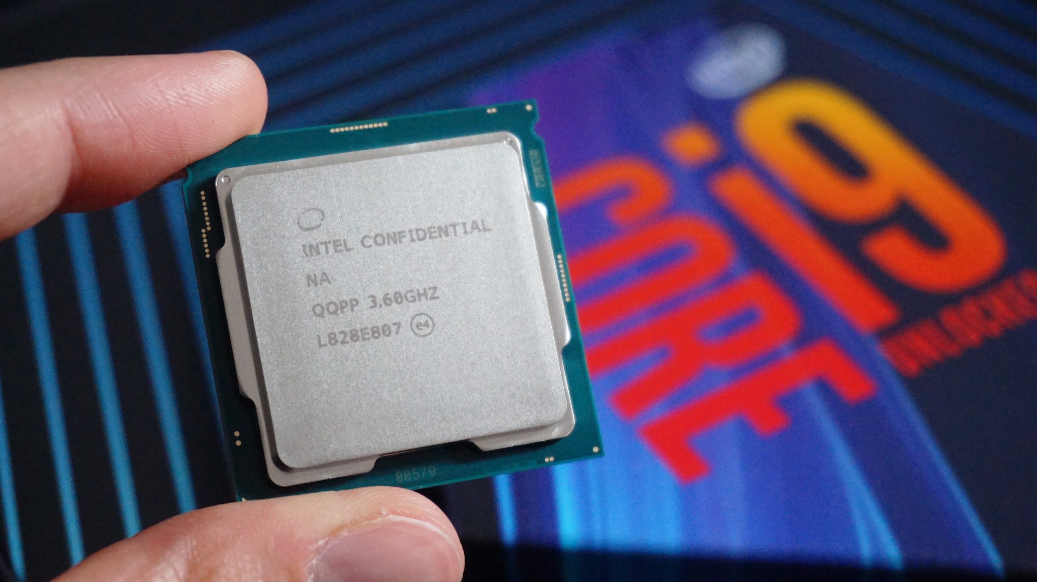
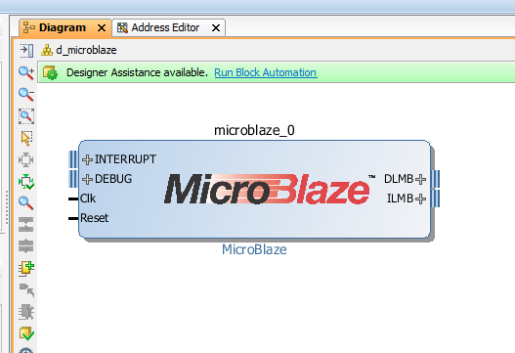
Background: Physical vs. Soft-Core Processors
Physical Processors: Cores within the central processing unit that handles processing. These may contain several logical cores which use multithreading to run two processes simultaneously on the same chip.
i.e. : Intel i3, i5, i7, i9
Soft-Core Processors: Cores created from the resources contained on a FPGA chip. These processors are often limited to a maximum 250MHz
I.e. : Altera NIOS II, Xilinx Microblaze

Slide 6
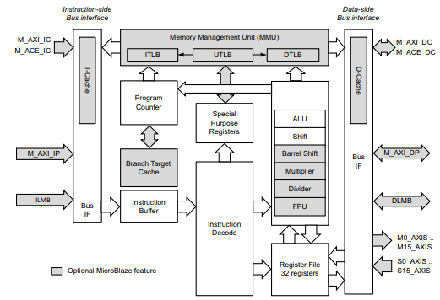
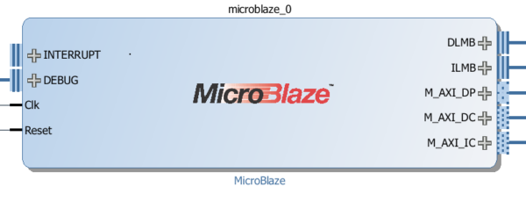
Background: Microblaze
32-bit Harvard based SoftCore Processor
RISC
5 stage pipelining, when optimized for performance, 3 stage when designed for normal operation
Configurable Instruction and Data Caches
Lock Step interfacing for fault tolerant designs
Compatibility with ARM processors

Slide 7
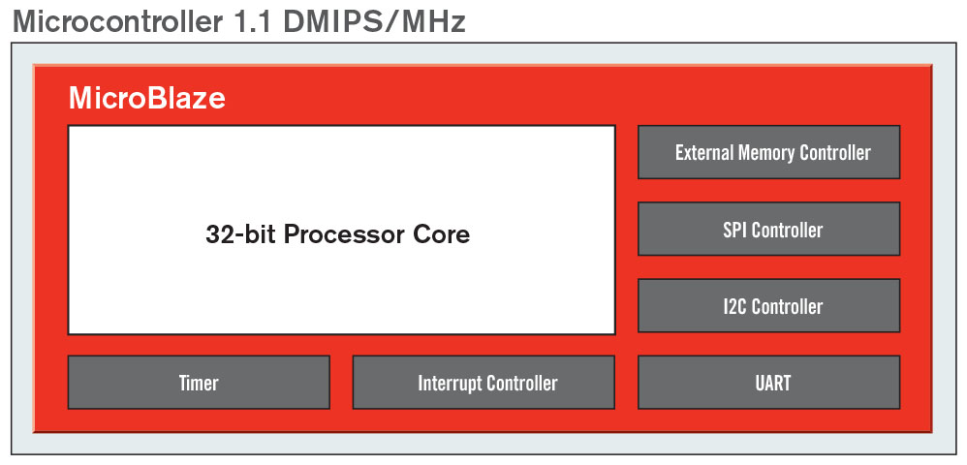
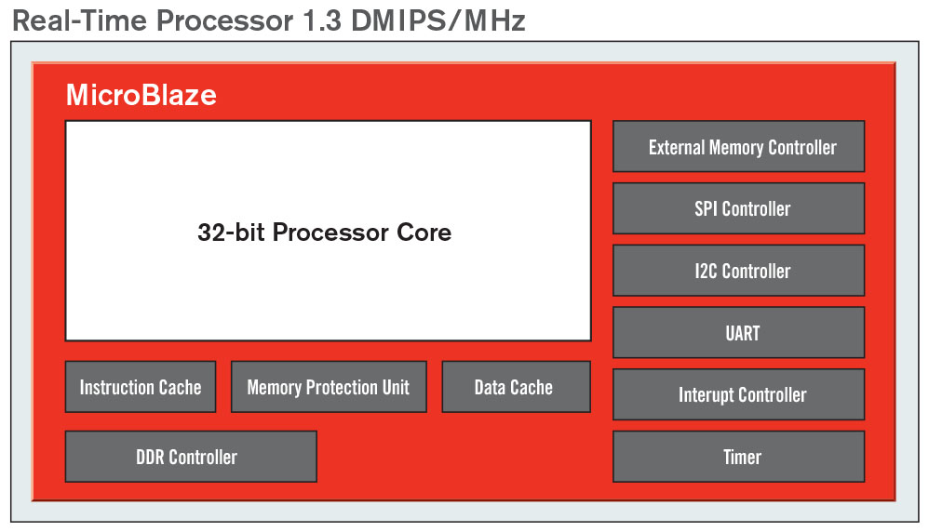
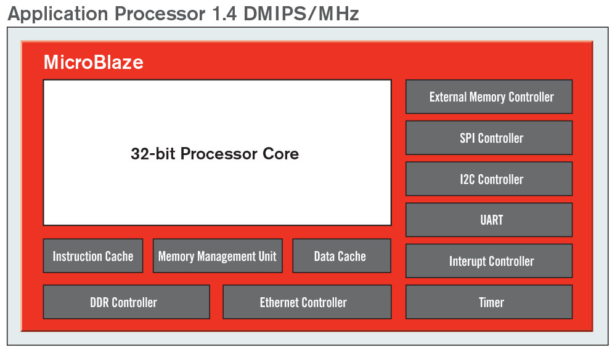
Background: Microblaze
Microblaze has three preset configurations:
Microcontroller Preset:
32-bit processing core, external memory controller, interrupt controller, timer
Real Time Processor Preset
All microcontroller presets, instruction/data cache, DDR controller, Memory Protection Unit
Application Processor Preset
All real time processor presets, memory management unit, ethernet controller
For our design we will be using a custom configuration consisting of several of these features

Slide 8
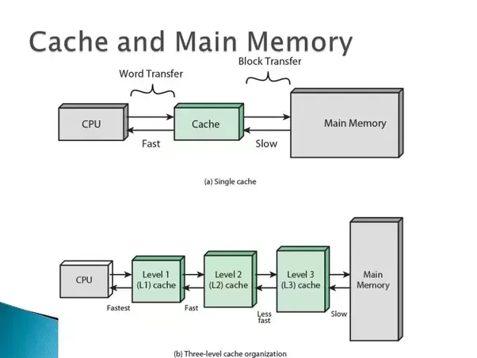
Background: Memory Design
One of the most expensive parts of system is the cache memory
Typically divided into 3 categories L1, L2, L3
All different forms of Static Random Access Memory(SRAM)
Prices range from $500-$1000 per GB
I.e.: i9-9900k (L1 = 512kB, L2 = 2MB, L3 = 12MB)
For this design, we are limited to BRAMfrom the Basys 3 boards
Microblaze is using about 128KB for both I and D memories

Slide 9
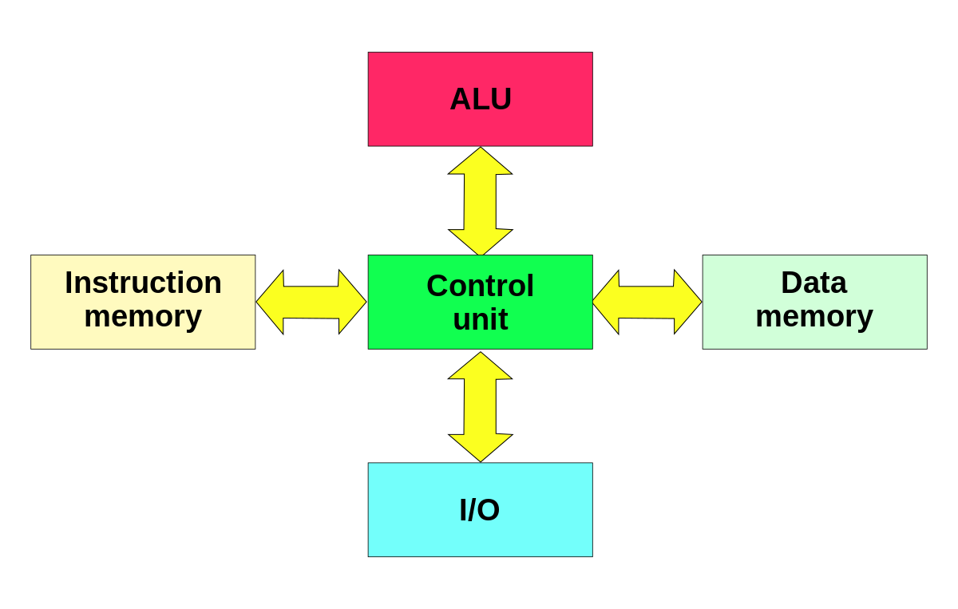
Background: Memory Management
In order to create an optimal multicore system, each instance of Microblaze must be connected to one block ram containing both instruction and data caches, considered to be a Memory Management Unit (MMU)
An effective MMU performs virtual memory management while at the same time handling memory protection, cache control and bus arbitration
Develop custom IP as our MMU
Developing a DDR3 Controller to connect to PMOD on FPGA

Slide 10
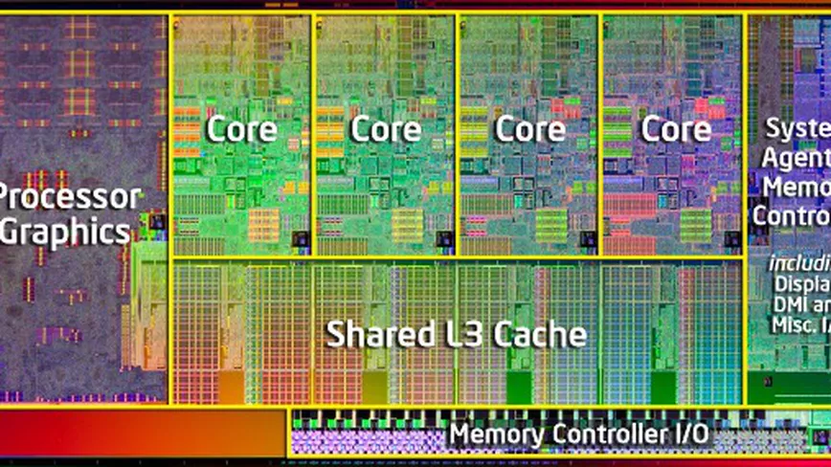
Requirements: MultiCore Processing and Scalable Design
Multi vs single
Benefits of multicore
High Computational throughput
Core Optimization
Multi Data Pipelining
Single core performance has peaked since 2006 [Borkar & Chien, 2011]
Notes:
researchers have observed that single-thread performance has already leveled off, with only modest increases expected in the coming decades

Slide 11
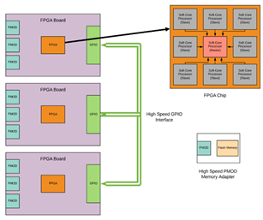
Requirements: MultiCore Processing and Scalable Design
Parallel FPGA design options:
Connecting multiple boards via ethernet ports
Using GPIO pin connections while executing our own transfer protocol
High Speed PCI-E Interface
MicroBlaze as a Co-processor:
Master / Slave configuration
Combining the MicroBlaze with an ARM core
Using ARM processor to divide workload
Notes:
Each board will have a master MicroBlaze, similar to a memory management unit, in control of multiple slave Micro-Blazes to share the load more efficiently

Slide 12

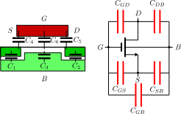
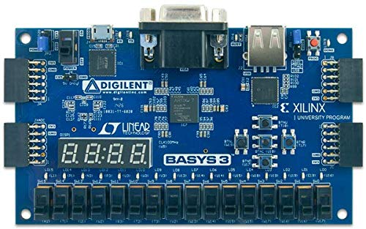
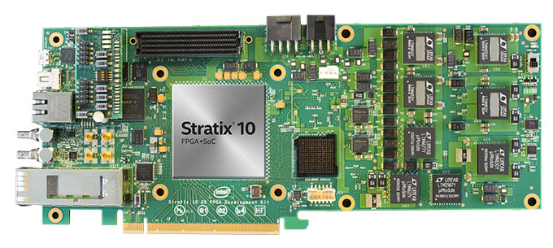
Constraints
Heat Dissipated
Parasitic capacitance
Leakage current
Short Circuit
Retains Heat
Slower Clock Rate
Reduces overall performance
Cost
Extreme price
Notes:
Although number of transistors increased, clock speed is limited due to heat dissipation
Three components for heat dissipation:
1. The capacitance associated with a transistor which affects components around it
2. The leakage current increases as the transistor becomes smaller.
3. The short circuit current which leads to a power dissipation

Slide 13
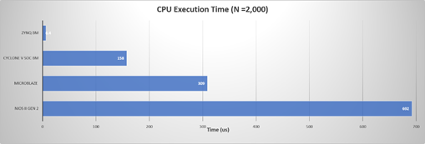
Design: Benchmarking Results
Microblaze in comparison to other platforms:
Sieve of Eratosthenes (Prime Numbers)
Outperforms other softcore processors
Has lower power consumption

Slide 14
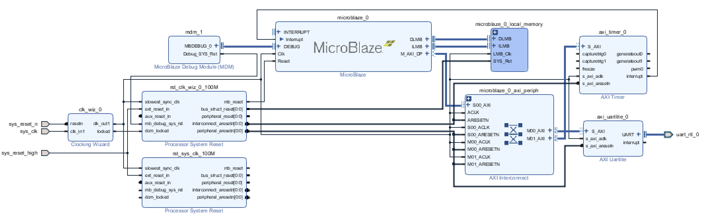
Design: Current Implementation

Slide 15
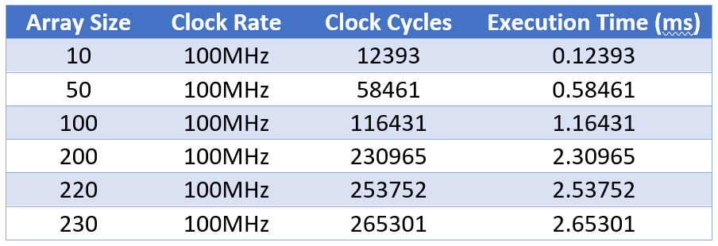
Design: Benchmarking Results
Demo - Execution Time Results

Slide 16
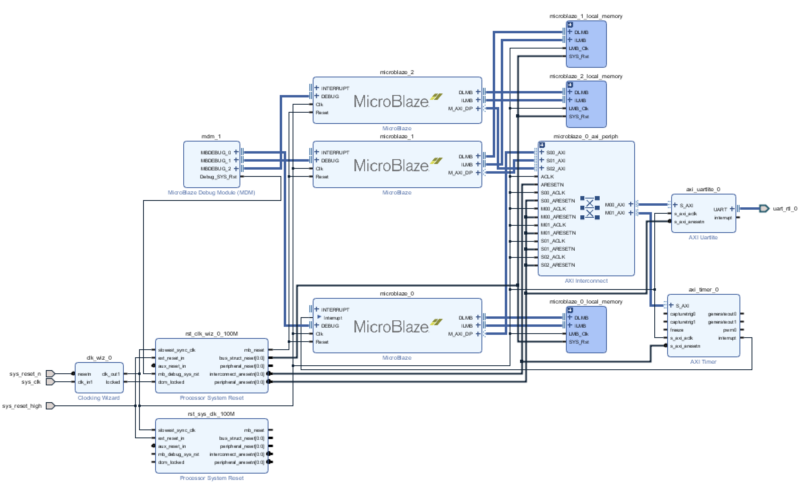
Design: Pipelined Design

Slide 17
Encryption Testing using FPGAs
FPGAs have the computational power to run dedicated encryption algorithms at a low rate of power consumption. In order to prove this idea, We will be using the Microblaze across various test platforms, as well as running new algorithms developed for the LWC competition.

Slide 18
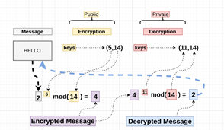
RSA Encryption
The first encryption that we used for testing was the RSA encryption. To begin with, the encryption mainly consists of an asymmetric cryptographic algorithm to decode messages. In other words, the encryption will have two different keys utilized in the algorithm. The first key will be a public key that can be shared with anyone. This key is mainly used for encrypting the message, so anyone has the ability to encrypt the data that they desire.

Slide 19
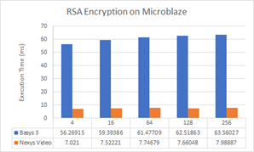
RSA Results

Slide 20
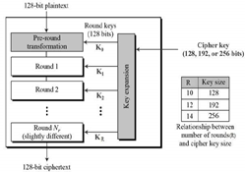
AES Encryption
When compared to RSA, this encryption is actually a symmetric cryptographic algorithm that is used when decoding messages. In this case, the same generated key will be used for encrypting and decrypting the data at the same time. As a result, this key should be kept private since the inverse method will use the same key when decrypting the message. The entire AES encryption mainly uses a principle known as a substitution permutation network. This principle is very efficient in hardware and software, which will be sufficient for security while also being efficient at the same time.

Slide 21
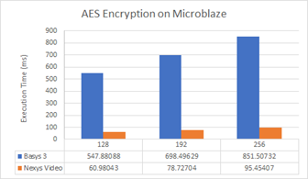
AES Results

Slide 22
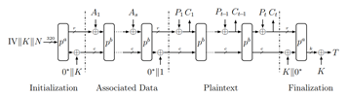
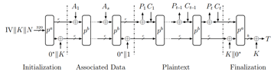
ASCON128 Encryption
The third algorithm that was tested was ASCON128. ASCON 128 is a lightweight authenticated encryption algorithm created in response to the annual CAESAR competition. The inputs for the encryption procedure contain a plaintext P, associated data A, a secret key K with k bits and a public message number (nonce) N with k bits. The output of the authenticated encryption procedure is an authenticated ciphertext C which is exactly the same length as the plaintext P, and an authentication tag T of size k bits, which authenticates both A and P

Slide 23
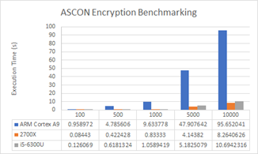
ASCON128 Results

Slide 24
References/Bibliography
[1]https://scholarworks.gvsu.edu/cgi/viewcontent.cgi?article=1843&context=theses
[2]https://www.xilinx.com/support/documentation/sw_manuals/xilinx2018_3/ug984-vivado-microblaze-ref.pdf
[3]https://www.xilinx.com/support/documentation/sw_manuals/xilinx2018_3/ug973-vivado-release-notes-install-license.pdf
[4]https://scholarworks.gvsu.edu/cgi/viewcontent.cgi?article=1843&context=theses
[5]https://scholarsarchive.byu.edu/cgi/viewcontent.cgi?referer=https://www.google.com/&httpsredir=1&article=6508&context=etd
[6]http://proxy.library.cpp.edu/login?url=http://search.ebscohost.com/login.aspx?direct=true&AuthType=ip,uid&db=aph&AN=19497752&site=ehost-live&scope=site
[7]http://proxy.library.cpp.edu/login?url=http://search.ebscohost.com/login.aspx?direct=true&AuthType=ip,uid&db=aph&AN=19497752&site=ehost-live&scope=site

Slide 25
Questions?

